Slide 1
Unit 1
Introduction to Cloud

Slide 2
Introduction to Cloud
Cloud Computing
Cloud computing delivers services over the internet using remote servers, offering scalability and accessibility. Traditional computing relies on local servers, requiring upfront hardware investments and maintenance. The key distinction lies in where and how services are hosted, impacting flexibility, cost-effectiveness, and ease of access.
Storing and accessing of data and computing services over the internet.
Cloud computing is the delivery of computing services—including servers, storage, databases, networking, software, analytics, and intelligence—over the Internet (“the cloud”) to offer faster innovation, flexible resources, and economies of scale.

Slide 5
Aspect | Cloud Computing | Traditional Computing
Definition | Cloud Computing refers to delivery of different services such as data and programs through internet on different servers. | Traditional Computing refers to delivery of different services on local server.
Infrastructure Location | Cloud Computing takes place on third-party servers that is hosted by third-party hosting companies. | Traditional Computing takes place on physical hard drives and website servers.
Data Accessibility | Cloud Computing is ability to access data anywhere at any time by user. | User can access data only on system in which data is stored.
Cost Effectiveness | Cloud Computing is more cost effective as compared to tradition computing as operation and maintenance of server is shared among several parties that in turn reduce cost of public services. | Traditional Computing is less cost effective as compared to cloud computing because one has to buy expensive equipment’s to operate and maintain server.
User-Friendliness | Cloud Computing is more user-friendly as compared to traditional computing because user can have access to data anytime anywhere using internet. | Traditional Computing is less user-friendly as compared to cloud computing because data cannot be accessed anywhere and if user has to access data in another system, then he need to save it in external storage medium.

Slide 6
Aspect | Cloud Computing | Traditional Computing
Internet Dependency | Cloud Computing requires fast, reliable and stable internet connection to access information anywhere at any time. | Traditional Computing does not require any internet connection to access data or information.
Storage and Computing Power | Cloud Computing provides more storage space and servers as well as more computing power so that applications and software run must faster and effectively. | Traditional Computing provides less storage as compared to cloud computing.
Scalability and Elasticity | Cloud Computing also provides scalability and elasticity i.e., one can increase or decrease storage capacity, server resources, etc., according to business needs. | Traditional Computing does not provide any scalability and elasticity.
Maintenance and Support | Cloud service is served by provider’s support team. | Traditional Computing requires own team to maintain and monitor system that will need a lot of time and efforts.
Software Delivery Model | Software is offered as an on-demand service (SaaS) that can be accessed through subscription service. | Software in purchased individually for every user and requires to be updated periodically.

Slide 7
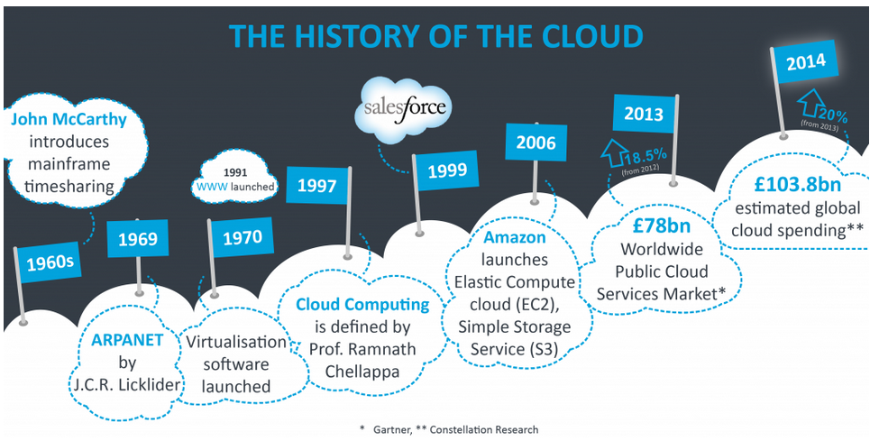

Slide 8
Cluster Computing
Cluster computing refers to the process of sharing the computation task to multiple computers of the cluster. The number of computers are connected on a network and they perform a single task by forming a Cluster of computers where the process of computing is called as cluster computing.
Cluster Computing is a high performance computing framework which helps in solving more complex operations more efficiently with a faster processing speed and better data integrity. Cluster Computing is a networking technology that performs its operations based on the principle of distributed systems.

Slide 9
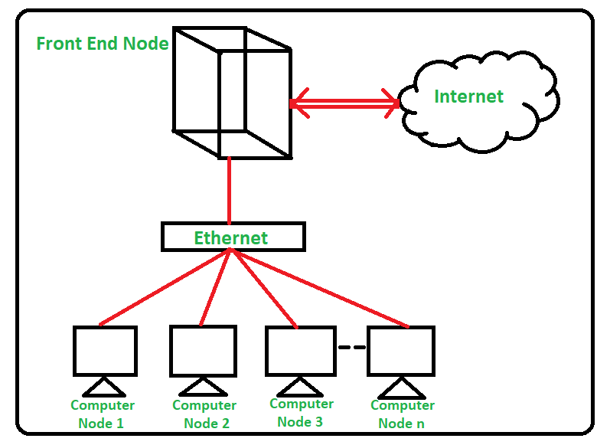
Cluster Computing

Slide 10
Difference between Cloud Computing and Cluster Computing
Serial Number | Category | Cloud Computing | Cluster Computing
1. | Goal | Providing on demand IT resources and services. | Performing a complex task in a modular approach.
2. | Resource Sharing | Specific assigned resources are not shareable. | Specific assigned resources are not shareable.
3. | Resource type | In cloud computing there is heterogeneous resource type. | In Cluster Computing there is homogeneous resource type.
4. | Virtualization | Virtualization hardware and software resources. | No virtualization resources.
5. | Security | Security through isolation can be achieved. | Security through node credential can be achieved.
6. | Initial Cost | Initial capital cost for setup is very low. | Initial capital cost for setup is very high.

Slide 11
7. | Security Requirement | Very low | Very high
8. | Maintenance | Requires low maintenance. | Requires little more maintenance.
9. | Hardware | No hardware requirement physically. | More hardware requirement physically.
10. | Node OS | Multiple OS runs in VM | Windows, Linux
11. | User Management | User management is centralized or decentralized to vendor/third party. | User management is centralized.
12. | Scalability | Allowed | Limited
13. | Architecture | In Cloud Computing User chosen architecture. | In Cluster Computing Cluster oriented architecture

Slide 12
Grid Computing
Grid computing is a distributed architecture of multiple computers connected by networks to accomplish a joint task. These tasks are compute-intensive and difficult for a single machine to handle. Several machines on a network collaborate under a common protocol and work as a single virtual supercomputer to get complex tasks done. This offers powerful virtualization by creating a single system image that grants users and applications seamless access to IT capabilities.
Grid computing operates by running specialized software on every computer involved in the grid network. The software coordinates and manages all the tasks of the grid. Fundamentally, the software segregates the main task into subtasks and assigns the subtasks to each computer. This allows all the computers to work simultaneously on their respective subtasks. Upon completion of the subtasks, the outputs of all computers are aggregated to complete the larger main task.
The software allows computers to communicate and share information on the portion of the subtasks being carried out. As a result, the computers can consolidate and deliver a combined output for the assigned main task.

Slide 13
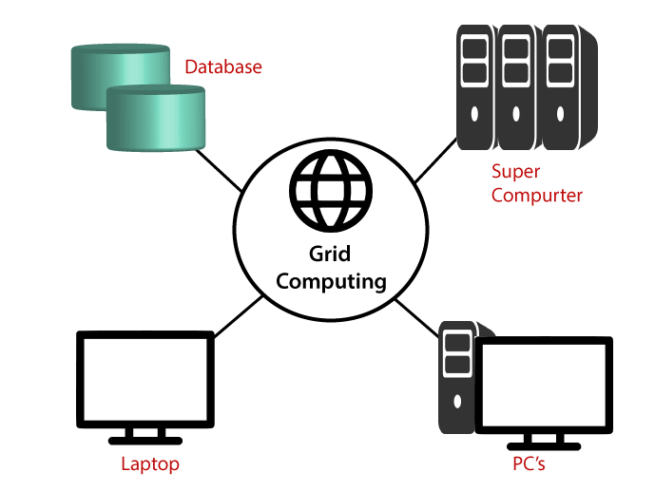
Grid Computing

Slide 14
Difference between Cloud Computing and Grid Computing
Cloud Computing | Grid Computing
Cloud computing is a Client-server computing architecture. | While it is a Distributed computing architecture.
Cloud computing is a centralized executive. | While grid computing is a decentralized executive.
In cloud computing, resources are used in centralized pattern. | While in grid computing, resources are used in collaborative pattern.
It is more flexible than grid computing. | While it is less flexible than cloud computing.
In cloud computing, the users pay for the use. | While in grid computing, the users do not pay for use.
Cloud computing is a high accessible service. | While grid computing is a low accessible service.

Slide 15
It is highly scalable as compared to grid computing. | While grid computing is low scalable in comparison to cloud computing.
It can be accessed through standard web protocols. | While it is accessible through grid middleware.
Cloud computing is based on service-oriented. | Grid computing is based on application-oriented.
Cloud computing uses service like IAAS, PAAS, SAAS. | Grid computing uses service like distributed computing, distributed information.

Slide 16
Characteristics of Cloud Computing
On-demand self-services: The Cloud computing services does not require any human administrators, user themselves are able to provision, monitor and manage computing resources as needed.
Broad network access: The Computing services are generally provided over standard networks and heterogeneous devices.
Rapid elasticity: The Computing services should have IT resources that are able to scale out and in quickly and on a need basis. Whenever the user require services it is provided to him and it is scale out as soon as its requirement gets over.
Resource pooling: The IT resource (e.g., networks, servers, storage, applications, and services) present are shared across multiple applications and occupant in an uncommitted manner. Multiple clients are provided service from a same physical resource.
Measured service: The resource utilization is tracked for each application and occupant, it will provide both the user and the resource provider with an account of what has been used. This is done for various reasons like monitoring billing and effective use of resource.
Multi-tenancy: Cloud computing providers can support multiple tenants (users or organizations) on a single set of shared resources.

Slide 17
Virtualization: Cloud computing providers use virtualization technology to abstract underlying hardware resources and present them as logical resources to users.
Resilient computing: Cloud computing services are typically designed with redundancy and fault tolerance in mind, which ensures high availability and reliability.
Flexible pricing models: Cloud providers offer a variety of pricing models, including pay-per-use, subscription-based, and spot pricing, allowing users to choose the option that best suits their needs.
Security: Cloud providers invest heavily in security measures to protect their users’ data and ensure the privacy of sensitive information.
Automation: Cloud computing services are often highly automated, allowing users to deploy and manage resources with minimal manual intervention.
Sustainability: Cloud providers are increasingly focused on sustainable practices, such as energy-efficient data centers and the use of renewable energy sources, to reduce their environmental impact.

Slide 18
Advantages of Cloud Computing
Scalability: Cloud computing allows organizations to easily scale their computing resources up or down as their needs change, without having to purchase and manage additional hardware.
Cost Savings: Using cloud computing can be more cost-effective than maintaining on-premises IT infrastructure, as it eliminates the need for costly hardware, software, and maintenance expenses.
Accessibility: Cloud computing enables remote access to applications and data, allowing users to work from anywhere with an internet connection.
Reliability: Cloud providers offer high levels of uptime and redundancy, ensuring that applications and data are available even in the event of hardware failure.
Flexibility: Cloud computing offers a wide range of deployment options, including public, private, and hybrid clouds, which can be tailored to meet the unique needs of an organization.

Slide 19
Disadvantages of Cloud Computing
Security: Cloud computing involves sharing sensitive data with a third-party provider, which raises concerns about data security and privacy.
Dependence: Organizations that rely on cloud providers for their computing infrastructure are vulnerable to service disruptions or data loss in the event of provider outages or other issues.
Internet Dependency: Cloud computing requires a reliable and fast internet connection to access applications and data, which can be a challenge in some areas.
Technical Issues: Technical issues with cloud services, such as compatibility problems or software bugs, can sometimes be difficult to resolve and can result in downtime or lost productivity.
Lack of Control: With cloud computing, organizations have limited control over the infrastructure and services they use, which can make it difficult to customize or optimize the environment for their specific needs.

Slide 20
Introduction to Dockers Container
Docker is a containerization platform that enables developers to package and distribute applications and their dependencies as lightweight, portable containers. Containers are isolated environments that encapsulate an application and its dependencies, ensuring consistency across different environments.

Slide 21
Use Cases of Docker
Application Deployment and Scaling:
Docker simplifies the deployment process, making it easier to package and distribute applications. It also facilitates the scaling of applications by replicating containers across multiple hosts.
Micro services Architecture:
Docker is well-suited for micro services architectures, allowing developers to build, deploy, and scale individual services independently in separate containers.
Continuous Integration/Continuous Deployment (CI/CD):
Docker containers streamline the CI/CD pipeline, ensuring that applications behave consistently across development, testing, and production environments.
DevOps Practices:
Docker enhances collaboration between development and operations teams by providing a standardized environment, reducing conflicts and discrepancies between development and production environments.

Slide 22
Platforms for Docker
Docker Desktop:
- Ideal for local development and testing.
- Available for Windows and macOS.
- Provides a user-friendly interface for managing containers.
Docker Hub:
- A cloud-based registry for sharing and distributing Docker images.
- Offers a vast repository of pre-built images for popular software.
Docker Enterprise:
- Designed for enterprise-level container orchestration and management.
- Provides advanced features for security, scalability, and collaboration.

Slide 23
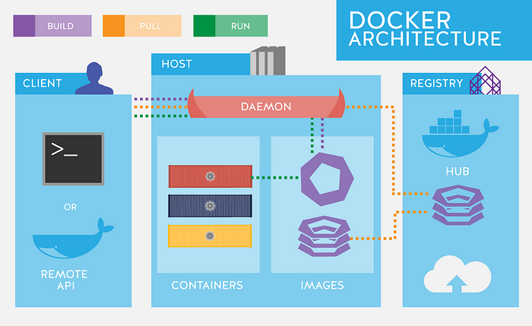
Docker Architecture
Docker employs a client-server architecture with a set of components that work together to facilitate the containerization process. Understanding these components is crucial for effectively working with Docker.

Slide 24
Docker Daemon:
The Docker daemon (dockerd) is a background process that manages Docker containers on a host system. It is responsible for building, running, and managing containers. The daemon listens for Docker API requests and communicates with the Docker CLI (Command Line Interface) or other tools.
Docker Client:
The Docker client (docker) is a command-line tool or API that allows users to interact with the Docker daemon. It serves as the primary interface for developers to build, manage, and deploy containers. The client sends commands to the Docker daemon, which then executes them.
Docker Images:
Docker images are lightweight, standalone, and executable packages that include application code, libraries, dependencies, and the runtime environment. Images serve as the blueprint for creating containers. They can be stored in registries like Docker Hub and shared across different environments.

Slide 25
Docker Containers:
Containers are instances of Docker images that run as isolated processes on a host system. They encapsulate the application and its dependencies, providing a consistent and reproducible environment. Containers are portable and can run on any system that supports Docker.
Docker Registry:
A Docker registry is a centralized repository for storing and distributing Docker images. Docker Hub is a public registry, but organizations often use private registries for hosting proprietary images. Registries facilitate the sharing and versioning of Docker images across teams and environments.

Slide 26
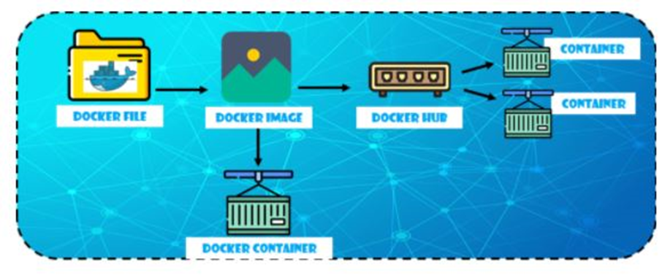

Slide 27
Docker Compose:
Docker Compose is a tool for defining and running multi-container Docker applications. It uses a YAML file to configure the services, networks, and volumes required for an application. Compose simplifies the process of managing complex, multi-container setups.
Docker Networking:
Docker provides networking capabilities to enable communication between containers and external networks. Containers can be connected to user-defined bridge networks, overlay networks for multi-host communication, or the host network for direct access.
Docker Volumes:
Docker volumes are used to persist data generated by and used by Docker containers. Volumes provide a way to share data between container instances and with the host system. They are crucial for handling data that needs to survive the lifecycle of containers.
Dockerfile:
Dockerfile is a text file that contains instructions for building a Docker image. It specifies the base image, sets up the environment, installs dependencies, and defines how the application should run. Dockerfiles are used in the image-building process.
Docker Swarm (Optional):
Docker Swarm is Docker's native orchestration tool for managing and scaling a cluster of Docker nodes. It enables the deployment of multi-container applications across multiple hosts, providing features for load balancing, service discovery, and rolling updates.

Slide 28
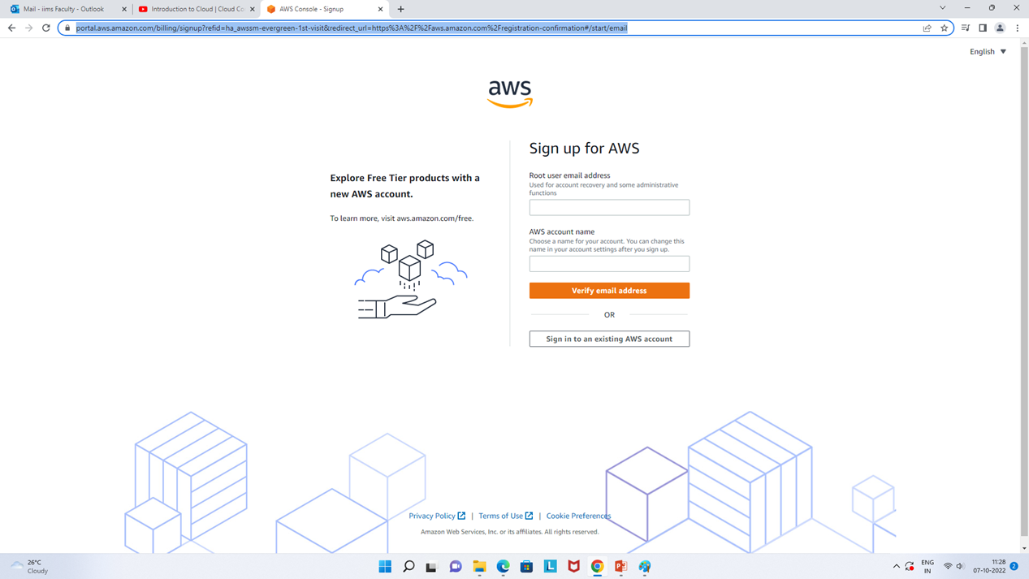
How to Creating cloud on AWS
https://aws.amazon.com/
https://portal.aws.amazon.com/billing/signup?refid=ha_awssm-evergreen-1st-visit&redirect_url=https%3A%2F%2Faws.amazon.com%2Fregistration-confirmation#/start/email

Slide 29
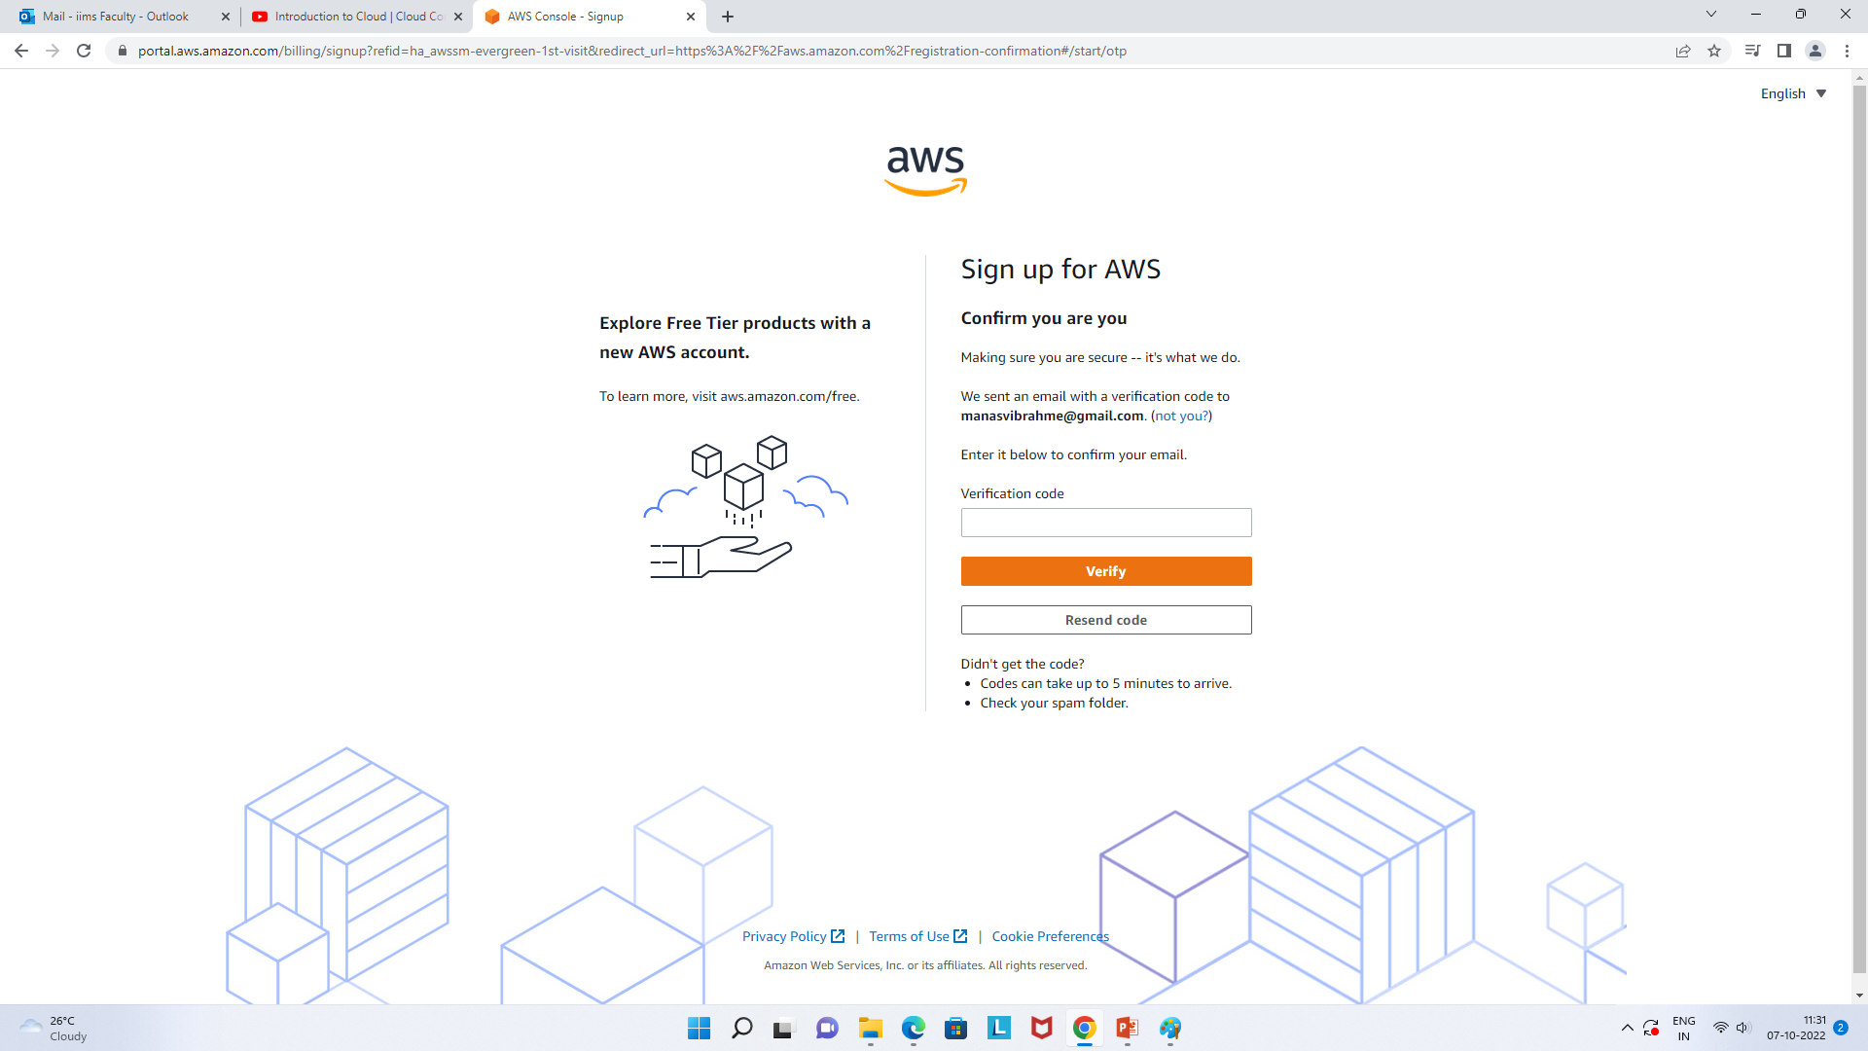
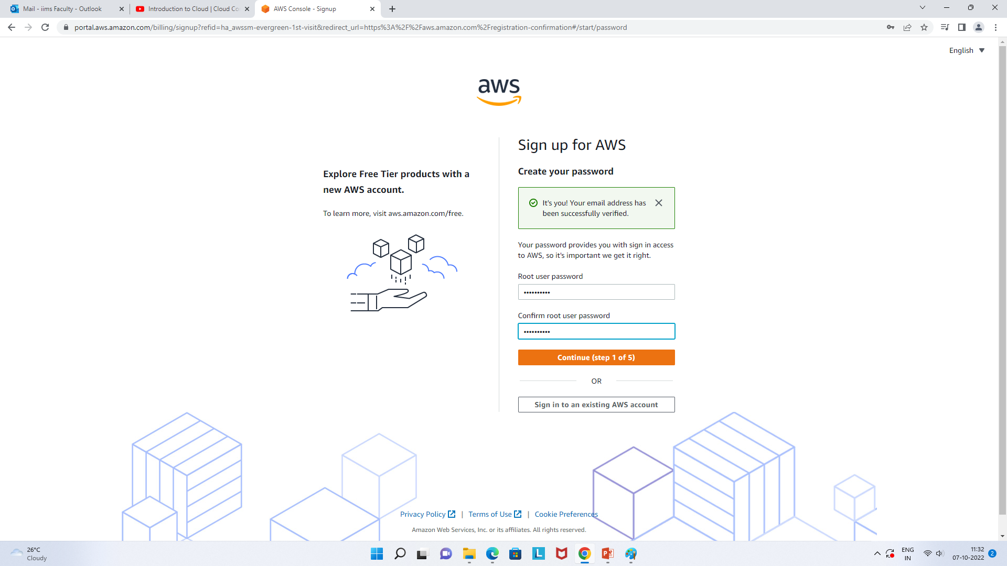

Slide 30
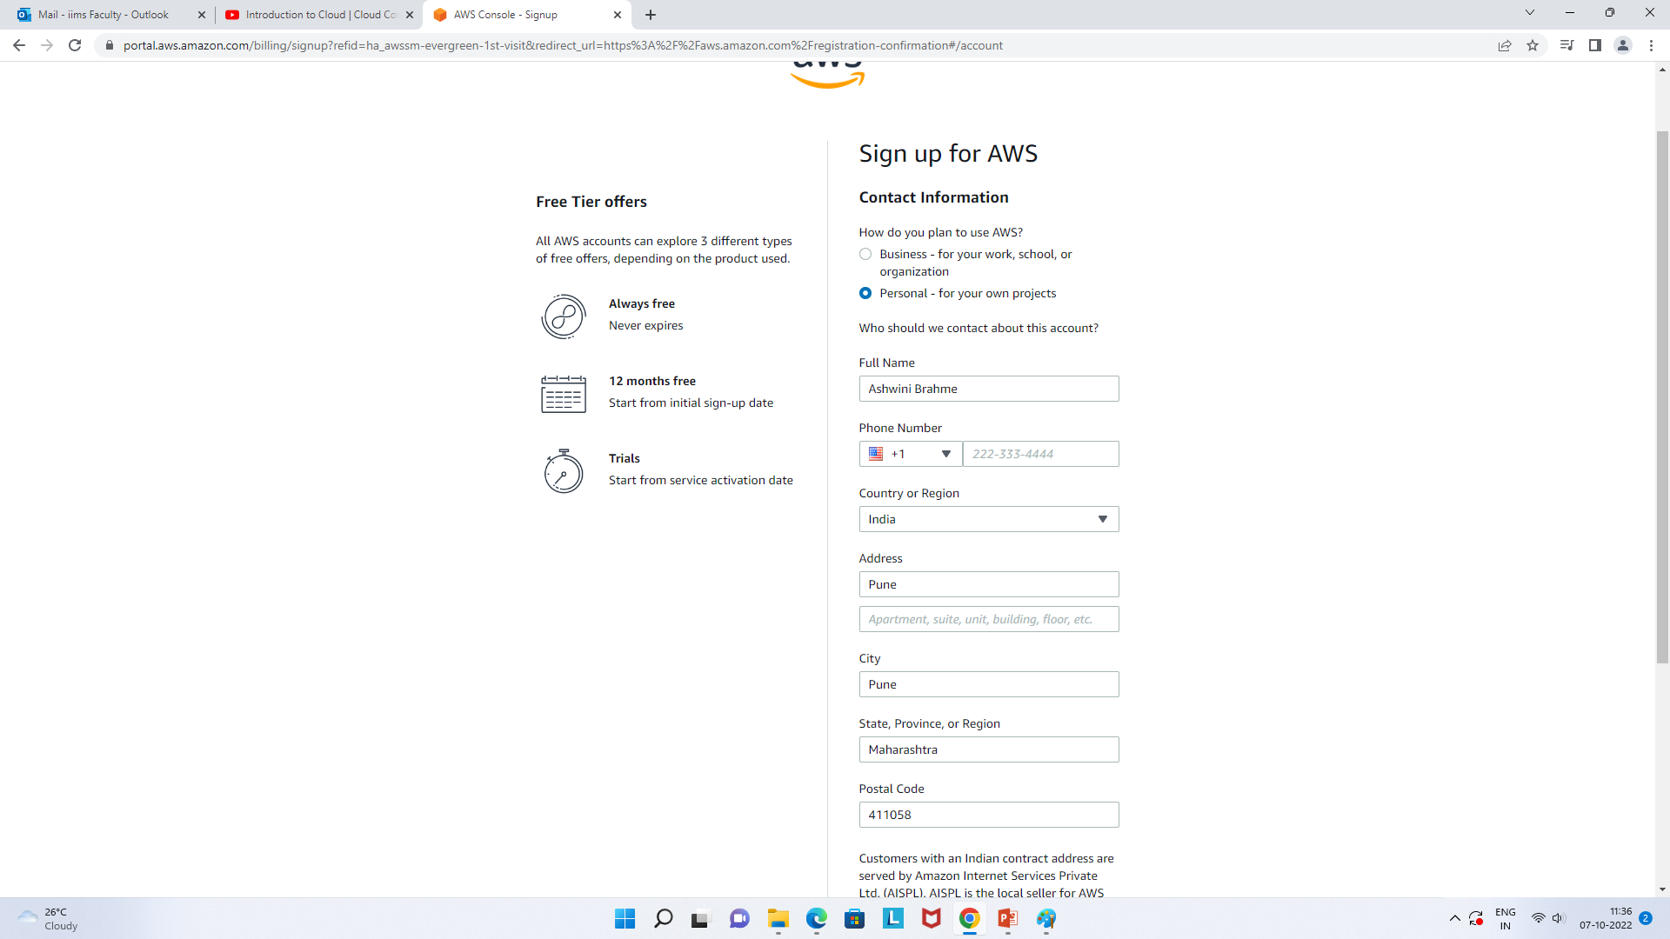

Slide 31
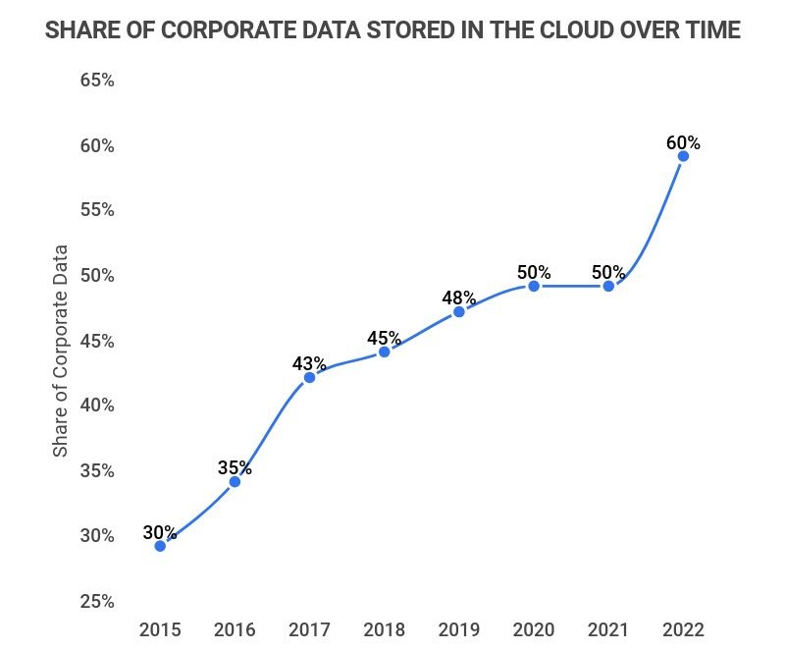

Slide 32
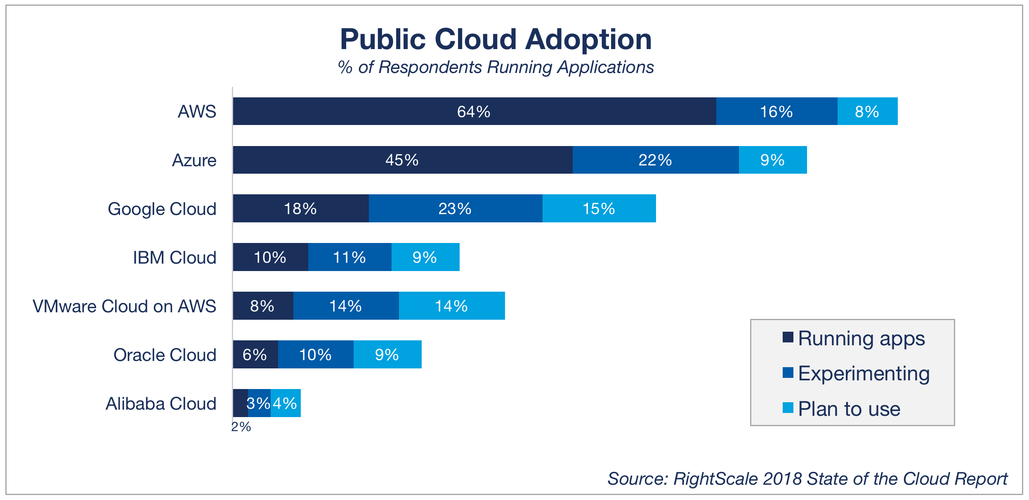

Slide 33
